Slide 1
Characters and Strings
CSC 101 – Introduction to Computer Science
Lecture 16
Department of
Computer Science and Engineering,
Independent University, Bangladesh
Some slides adopted from Gaddis

Slide 2
Character data type
Written between single quotes, length must be one: 'A', 'b', '*'
In C++, a char type variable is internally represented as a 8-bit integer, according to the ASCII table
Therefore a char can also be used & printed as integer (with type casting)
Example:
cout << 'a'; /* a is printed */
cout << (int)'a'; /* 97 is printed */
cout << (char)97; /* a is printed */

Slide 3
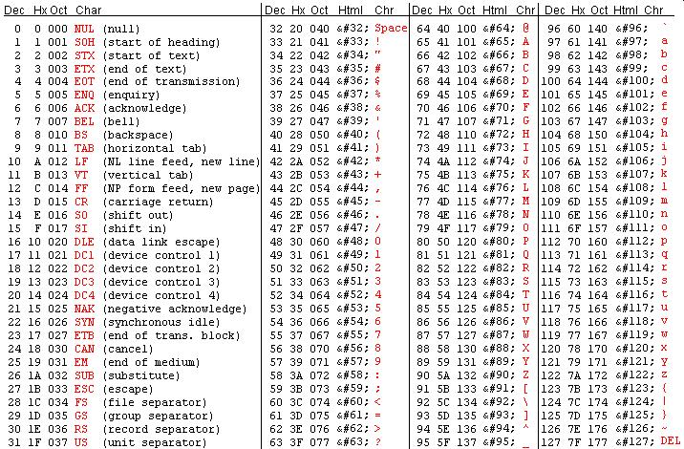
ASCII Table
Example: ASCII value of '7' is 55 but not 7!

Slide 4
char features
A | B | ... | Z | ... | a | b | ... | z
65 | 66 | ... | 90 | .. | 97 | 98 | ... | 122
  'a' + 1 has the value of 'b',
  'b' + 1 has the value of 'c', ...
test if character c is lower-case letter:
if ('a' <= c && c <= 'z') ... (recommended)
same as:
if (97 <=c && c <= 122) ... (not recommended)
If the variable c has the value of a lowercase letter, then the expression
c + 'A' – 'a' /* same as c + (65 -97)*/
has the value of the corresponding uppercase letter

Slide 5
Example – Print the ASCII code of a character
#include <iostream>
using namespace std;
void main(){
char c;
cout<<"Input a character: ";
cin>>c;
int num = (int)c; //type casting
cout<<"The ASCII code is "<<num;
}

Slide 6
Example – Conversion between upper/lower cases
#include <iostream>
using namespace std;
void main(){
char c1='D', c2='e', c3,c4;
c3=c1+'a'-'A'; //convert to lowercase
c4=c2+'A'-'a'; //convert to uppercase
cout<< "c3=" << c3 << ", c4=" << c4 << endl; //c3=d, c4=E
}

Slide 7
Reading a characters
char c1;
cin >> c1;
When cin >> c1 is executed, the program will ask the user for input (skipping all <space>/<enter> characters)
Q: What if the user inputs more than 1 character ?
A: The extra characters are stored in the input buffer in memory. When later >> are encountered, content from the buffer is returned directly without waiting for user input.

Slide 8
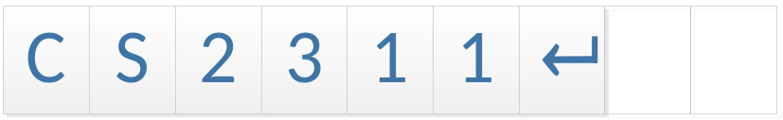
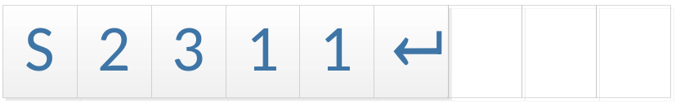
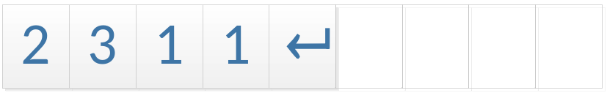
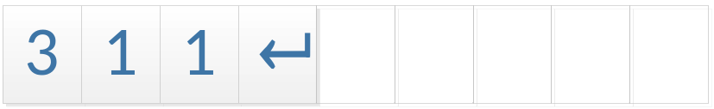
Some facts about keyboard Input
char c1,c2,c3;
cin >> c1; //enter the string "CS2311", c1 get 'C'
cin >> c2; //c2 get the character 'S' from buffer
cin >> c3; //c3 get the character '2' from buffer
 | c1 | c2 | c3 | Input buffer
(user input " cs2311")
cin >> c1; | 'C'
cin >> c2; | 'C' | 'S'
cin >> c3; | 'C' | 'S' | '2'

Slide 9
Example
Write a program which reads a character from the user and output the character type.
The program should distinguish between the following types of characters
  An upper case character ('A'-'Z')
  A lower case character ('a'-'z')
  A digit ('0'-'9')
  Special character (e.g. '#', '$', etc)

Slide 10
Exercise – Fill in the missing parts
#include<iostream>
using namespace std;
void main(){
char c;
cin >> c;
if ( )
cout << "An upper case character\n";
else if ( )
cout << "A lower case character\n";
else if ( )
cout << "A digit\n";
else
cout << "Special character\n";
}

Slide 11
Answer
#include<iostream>
using namespace std;
void main(){
char c;
cin >> c;
if (c>='A' && c<='Z')
cout << "An upper case character\n";
else if (c>='a' && c<='z')
cout << "A lower case character\n";
else if (c>='0' && c<='9')
cout << "A digit\n";
else
cout << "Special character\n";
}
IMPORTANT: Note the difference
between '0' and 0

Slide 12
String -- as character array

Slide 13
cstring vs string object
In C++, there are two types of strings:
As an array of char (the same mechanism as the C language), also known as the so-called cstring
std::string class defined in C++ <string> library
(not covered in this course)

Slide 14
String : cstring
A cstring is a char array, which is terminated by the end-of-string mark (also called null character) '\0' (ASCII code:0).
In other words, whatever enclosed by double quotation marks “..”
will have '\0' automatically added to the end
Because you need '\0', so a character array of size n may stores only strings with a maximum length of n-1
Consider the definition
char str[20]="Hello World";
H
e
l
l
o
W
o
r
l
d
\0
This character array may store a string with maximum length of 19

Slide 15
Rule of Safety
Declare a string with at least one character more than needed
E.g.
  char X[4]="ABC"; //Correct
  char Y[3]="ABC"; //Wrong, 3 is not enough!
  char Y[3]="ABC"; is actually IDENTICAL to..
  char Y[3] = { 'A','B','C','\0' };
  Obviously a [3] array cannot store 4 characters!
Double quotation mark for string
Single quotation mark for character

Slide 16
cstring
Declaration and Initialization
String variable can be declared in one of the two ways:
Without initialization
  char identifier[required size+1] , for example:
    char name[12]; // name with 11 characters
    char Address[50]; // address with 49 characters
With initialization
  char identifier=string constant , for example:
    char name[5]="John"; //name with 5 characters
    char name[]="John"; //also ok
    char name[5]={'J','o','h','n','\0'}; //also ok
However, you cannot initialize a string after declaration
  char name[10];
  name="john"; // wrong!
error C2440: '=' : cannot convert from 'const char [5]' to 'char [10]'

Slide 17
cstring : Reading and Printing
#include<iostream>
using namespace std;
void main(){
char word[20];
//read a string
cin >> word;
cout << word; //print a string
}
The array word can store 20 characters but we can only store up to 19 “useful” characters (need to reserved 1 char for ‘\0’)
Note: cin would not check the size of array, hence inputting long string
(>19 chars) can result in runtime error!

Slide 18
Reading a line of characters
cin >> str will terminate when white space characters (<space>, <tab>, or <enter>) are encountered
Suppose "hello world" is inputted
  char s[20];
  cin >> s; //read ONLY "hello"
  cin >> s; //read "world"
cin >> could not be used directly (as a single read operation)
if the string contains spaces

Slide 19
Read one character with cin.get
#include <iostream>
using namespace std;
void main(){
char c;
do {
cin.get(c);
cout << c;
}while (c!='\n');
}

Slide 20
Read one character with cin.get
get(): member function of cin to read in one character from input
Unlike cin>> , cin.get() won't skip over white spaces
Syntax:
  char c;
  cin.get(c);

Slide 21
Read one line with cin.getline
Member function of cin to read in a line of text
(including spaces) up to the <enter> character
(or until the specified number of characters are read)
Two arguments:
  char array to receive the input
  size of the char array
Suppose "hello world" is inputted
This time you get the full string
but not just "hello"
#include <iostream>
using namespace std;
void main(){
char s[20];
cin.getline(s,20);
cout << "\"" << s << "\"" << end;
}

Slide 22
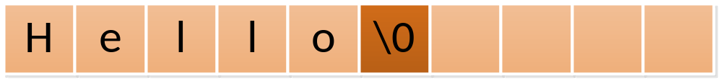
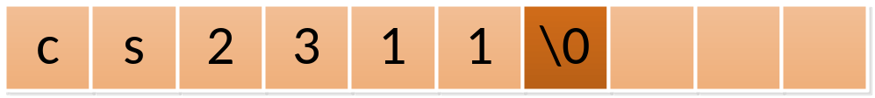
The Null Character '\0'
The null character '\0', is used to mark the end of a cstring
'\0' is a single character (although written in two symbols)
ASCII code of the null character is 0

Slide 23
Why we need '\0'?
cstring is stored in main memory continuously
When the cstring is passed to functions (e.g. output with cout), only the start address is passed. (because the string is array).
cout actually have NO IDEA how long the string is!
cout simply keeps printing until '\0' is encountered.

Slide 24

What if there's no '\0'?
#include <iostream>
using namespace std;
void main(){
int a=98765432;
char s[]="Hello world";
s[11]=' '; //deliberately overwrite the '\0'
cout << s <<endl;
}

Slide 25

The role of '\0'
Similarly, we can artificially use '\0' to truncate a string
#include <iostream>
using namespace std;
void main(){
char s[]="A string! A long long long long string!";
s[9]='\0'; //cut at position 9
//although characters 10...end are not changed,
//but they are not printed as they are after '\0'
cout << s <<endl;
}

Slide 26
Passing strings to functions
Example:
  Write a function to count the number of occurrences of a character in a string
Functions
  count: given a character and a string as input, return the number of occurrences of the character in the string
  main function: call count function

Slide 27
Function : count
int count(char s[100], char c){
int occurrence=0;
int i; //counter
for (i=0; s[i]!='\0'; i++){
if (s[i]==c)
occurrence++;
}
return occurrence;
}
The size 100 is optional
Should not write i<100 here as
the condition as the string could
be much shorter!
Writing i<100 will read 'garbage'
after the end of string

Slide 28
The main function
void main(){
char str[50]="Hong Kong is a very good place to live";
int count = count(str, 'o');
cout << "count = " <<count<< " \n");
}
Similar to using array, it's WRONG to write:
count(str[], 'o'); or
count(str[50],'o');

Slide 29
Another example: string length
#include<iostream>
using namespace std;
int strlength(char s[]){
int i=0;
while (s[i]!='\0')
i++;
return i;
}
void main(){
char s[20]="Hello world";
cout << strlength(s);
}

Slide 30
Reference Only
Copying strings with loop (and ‘\0’)
Other string functions in <cstring>
cin.ignore()
cin.fail()
cin.clear()

Slide 31
Copy cstrings without using library
Suppose there are two strings, str1 and str2
str1 is initialized to "Hello world"
Copy str1 to str2
  We CANNOT use the following expression to copy array elements
  str2=str1;
  Similarly, we CANNOT use the following expression to compare strings
  if (str1==str2) ......

Slide 32
Copy cstrings without using library
Use a loop to read characters one by one from str1 until a null character ('\0') is read
Copy the character to the corresponding position of str2
IMPORTANT:
Remember to put a null character at the end of str2

Slide 33
The program
#include<iostream>
using namespace std;
void main(){
char str1[20]="Hello world";
char str2[20];
int i;
/*beware of the boundary condition!*/
for (i=0; i<19 && str1[i]!='\0'; i++) {
str2[i]=str1[i];
}
str2[i]='\0';
cout << str2;
}

Slide 34
Some string functions in <cstring> library
Function | Description | Remarks
strcpy (dest,src) | Copy the content of string src to the string dest | No error check on whether the size of dest is enough for holding src
strcat (dest,src) | Append the content of string src onto the end of string dest | No error check on whether the size of dest is enough for holding src
strcmp(s1,s2) | Lexicographically compare two strings, s1 and s2, character by character. | 0: s1 and s2 are identical >0: s1 is less than s2 <0: s1 is greater than s1
strlen(string) | Returns the number of characters (exclude the null character) in the string

Slide 35
Examples:
#include <iostream>
#include <cstring>
using namespace std;
void main(){
char s1[50]="String 1";
char s2[50]="cs2363 computer programming";
cout <<"s1:"<< s1 <<endl;
cout <<"s2:" << s2<<endl;
strcpy(s1,"cs2311");
cout <<"s1:"<< s1 <<endl;
strcat(s1," computer programming");
cout <<"s1:"<< s1 <<endl;
cout <<"Compare s1 vs s2: " << strcmp (s1,s2) <<endl;
cout <<"Comprare s2 vs s1: " << strcmp (s2,s1) <<endl;
cout <<"Compare s1 vs \"cs2311 computer programming\":" << strcmp (s1,"cs2311 computer programming") <<endl;
}

Slide 36
Example
Write a program to print a word backward.
Example:
  Input:
    hello
  Output:
    olleh

Slide 37
The program – fill in the missing parts
#include<iostream>
#include<cstring>
using namespace std;
void main(){
char ____; //define an array input with size 20
int n; //length of str
int i;
cin >>____;
n=______; //compute string length
for (i=____; i >= 0 ;i--)
cout <<____ ;
}

Slide 38
The program
#include<iostream>
#include<cstring>
using namespace std;
void main(){
char input[50]; //define an array input with size 50
int n; //length of str
int i;
cin >> input;
n=strlen(input); //compute string length
for (i=n-1; i>=0; i--)
cout << input[i];
}

Slide 39
Exercise
Write a program to let the user input a line of string
The program should reverse the case of the input characters and print the result
  Lowercase characters are changed to uppercase.
  Uppercase characters are changed to lower case
Example input/output:
Hello World
hELLO wORLD

Slide 40
Program – fill in the missing parts
#include<iostream>
using namespace std;
void main(){
char s[20];
int i;
cin.getline(s);
for (i=0; s[i]!='\0'; i++){
if ( ) //uppercase letter
cout << ; //convert to lowercase
else if (s[i]>='a' && s[i]<='z') //lowercase letter
cout << ; //convert to uppercase
else //other characters
cout << ;
}
}

Slide 41
Answer
#include<iostream>
using namespace std;
void main(){
char s[20];
int i;
cin.getline(s);
for (i=0; s[i]!='\0'; i++){
if (s[i]>='A' && s[i]<='Z') //uppercase letter
cout << s[i]+'a'-'A'; //convert to lowercase
else if (s[i]>='a' && s[i]<='z') //lowercase letter
cout << s[i]+'A'-'a'; //convert to uppercase
else //other characters
cout << s[i] ;
}
}

Slide 42
cin.ignore (count, delimiter )
Function to skip number of characters from the keyboard buffer (or until the delimiter is encountered)
count: maximum number of characters to discard.
delimiter: a character which signals the end of the ignore/discard operation. (Note: the “delimiter” is also removed)
Example:
  cin.ignore(1000,'\n');
    /* skip at most 1000 characters or until '\n' is found, */
  cin.ignore(1000,'c');
    /* skip at most 1000 characters or until 'c' is found, */

Slide 43
Example
#include <iostream>
using namespace std;
void main(){
char name[20];
char address[20];
cin >> name;
cin.ignore(1000,'\n');
cin >> address;
cout << name <<':'<<address <<endl;
}

Slide 44
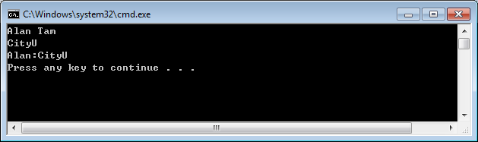
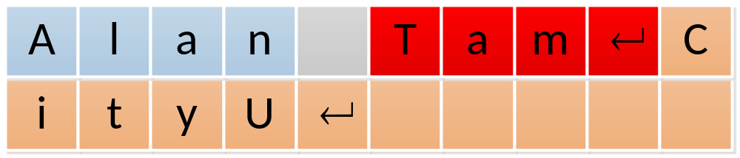
cin.ignore (count, delimiter )
Store in cstring "name"
Discarded by cin.ignore(..)

Slide 45
cin Error states
From time to time, user’s input could be deviated from the expectation
  e.g. cin>>integer but user input string
  e.g. cin>>getline and user typed more than the array size
For cases like that, cin.fail() will report true
The “error” status persists and may hinder later cin operations
Solution:
  Call cin.clear() to cancel all “error” status
  Possibly need to call cin.ignore() to remove incorrect input from the buffer

Slide 46
cin.fail() and cin.clear()
Let’s observe the different behaviors when string / integer are typed
#include<iostream>
using namespace std;
void main(){
int x;
while(1) {
cin>>x;
if (cin.fail()) {
cout<<"Error, input is not integer!\n";
cin.clear();
cin.ignore(1000,'\n'); //remove all illegal chars until ‘\n’
} else {
cout<<"OK, input is integer "<<x<<endl;
}
}
}

Slide 47
Summary
Character is a 8-bit integer (corresponding to ASCII code)
cin.get(…), cin.readline (…),
CString is an array of character terminated by '\0'
Access string content is similar to access individual element of an array
String copy, comparison, concatenate can be done by functions provided by <cstring> library

